Slide 1
What you will see is an animation of al Nakba :
the longest, largest ethnic cleansing in modern history.
The Zionist conquest of Palestine is shown step by step
every two weeks from 31st March 1948 to 15th April 1949 .
AL NAKBA ANATOMY
At every step, the following are shown:
The date
The Israeli conquest operation
The Massacres (flashing yellow)
The area of Jewish land (blue)
The area of occupied land (red)
The number of refugees
The number of depopulated villages
The incidence of truce and armistice agreements
Please wait few seconds after the running text disappears.
Click “ENTER” or Mouse to view next slide.

Slide 2
Date Israeli Conquest Operation
31 March 1948
Plan Dalet
Massacres
The Jewish land after the British Mandate
is only 5.4% of Palestine …
From the date of Partition in November 1947
to the end of March 1948,
the Zionists occupied Palestinian land
connecting Jewish colonies.
65,000 Zionist invaders were
resisted by 2,500 civilian defenders.

Slide 3
Date Israeli Conquest Operation
31 March 1948
Plan Dalet
15 April 1948
Nachson
Massacres
PLAN DALET STARTED…
More Zionist occupation ….
89 villages depopulated …
Dayr Yassin massacre took place…
while the British were watching …

Slide 4
Date Israeli Conquest Operation
31 March 1948
Plan Dalet
15 April 1948
Nachson
30 April 1948
Har’el Misparayim, Chametz, Yevussi
Massacres
Zionists attempted to conquer
the road to Jerusalem but failed.
134 villages depopulated.

Slide 5
Date Israeli Conquest Operation
31 March 1948
Plan Dalet
15 April 1948
Nachson
30 April 1948
Har’el Misparayim, Chametz, Yevussi
15 May 1948
Yiftach, Matate, Gideon, barak
250 villages were depopulated …
Half the total refugees were expelled …
41 massacres were committed …
while under the protection of the British Mandate.
Israel was declared on 13% of Palestine.

Slide 6
Date Israeli Conquest Operation
31 March 1948
Plan Dalet
15 April 1948
Nachson
30 April 1948
Har’el Misparayim, Chametz, Yevussi
15 May 1948
Yiftach, Matate, Gideon, barak
31 May 1948
Ben Ami, Qilshon, Ben Nun
Arab regular forces came
to rescue Palestine
… but failed.

Slide 7
Date Israeli Conquest Operation
31 March 1948
Plan Dalet
15 April 1948
Nachson
30 April 1948
Har’el Misparayim, Chametz, Yevussi
15 May 1948
Yiftach, Matate, Gideon, barak
31 May 1948
Ben Ami, Qilshon, Ben Nun
15 June 1948
Yoram
Zionist forces continued to advance…
More refugees expelled.

Slide 8
Date Israeli Conquest Operation
31 March 1948
Plan Dalet
15 April 1948
Nachson
30 April 1948
Har’el Misparayim, Chametz, Yevussi
15 May 1948
Yiftach, Matate, Gideon, barak
31 May 1948
Ben Ami, Qilshon, Ben Nun
15 June 1948
Yoram
30 June 1948
Truce
First Truce announced.
Used by Israelis to import more arms.

Slide 9
Date Israeli Conquest Operation
31 March 1948
Plan Dalet
15 April 1948
Nachson
30 April 1948
Har’el Misparayim, Chametz, Yevussi
15 May 1948
Yiftach, Matate, Gideon, barak
31 May 1948
Ben Ami, Qilshon, Ben Nun
15 June 1948
Yoram
30 June 1948
Truce
15 July 1948
Dani, Dekel, an Far
Israelis broke Truce
to occupy Arab Lydda and Ramle
and to build a bridgehead to Jerusalem.
More massacres …

Slide 10
Date Israeli Conquest Operation
31 March 1948
Plan Dalet
15 April 1948
Nachson
30 April 1948
Har’el Misparayim, Chametz, Yevussi
15 May 1948
Yiftach, Matate, Gideon, barak
31 May 1948
Ben Ami, Qilshon, Ben Nun
15 June 1948
Yoram
30 June 1948
Truce
15 July 1948
Dani, Dekel, an Far
31 July 1948
Qedem, Shoter
The coastal plain and parts of Galilee
are almost
completely emptied of
its Palestinian inhabitants.

Slide 11
Date Israeli Conquest Operation
31 March 1948
Plan Dalet
15 April 1948
Nachson
30 April 1948
Har’el Misparayim, Chametz, Yevussi
15 May 1948
Yiftach, Matate, Gideon, barak
31 May 1948
Ben Ami, Qilshon, Ben Nun
15 June 1948
Yoram
30 June 1948
Truce
15 July 1948
Dani, Dekel, an Far
31 July 1948
Qedem, Shoter
15 Aug 1948
Truce
31 Aug 1948
Truce
15 Sep 1948
Truce
30 Sep 1948
Truce
15 Oct 1948
Truce
Second Truce announced.
Israelis expelled inhabitants
of coastal villages
in violation of the Truce.
Elsewhere no refugees left
unless they were expelled.

Slide 12
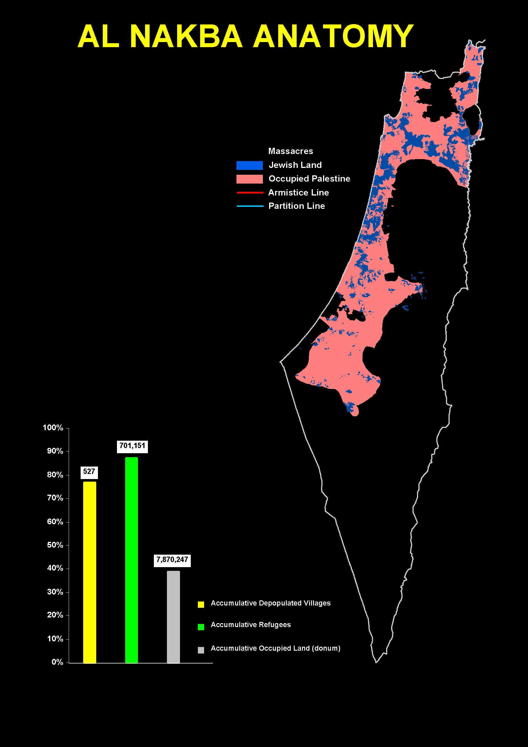
Date Israeli Conquest Operation
31 March 1948
Plan Dalet
15 April 1948
Nachson
30 April 1948
Har’el Misparayim, Chametz, Yevussi
15 May 1948
Yiftach, Matate, Gideon, barak
31 May 1948
Ben Ami, Qilshon, Ben Nun
15 June 1948
Yoram
30 June 1948
Truce
15 July 1948
Dani, Dekel, an Far
31 July 1948
Qedem, Shoter
15 Aug 1948
Truce
31 Aug 1948
Truce
15 Sep 1948
Truce
30 Sep 1948
Truce
15 Oct 1948
Truce
31 Oct 1948
ha har, Yo’av
Israelis broke second Truce
and swung south
to occupy Beer Sheba District.

Slide 13
Date Israeli Conquest Operation
31 March 1948
Plan Dalet
15 April 1948
Nachson
30 April 1948
Har’el Misparayim, Chametz, Yevussi
15 May 1948
Yiftach, Matate, Gideon, barak
31 May 1948
Ben Ami, Qilshon, Ben Nun
15 June 1948
Yoram
30 June 1948
Truce
15 July 1948
Dani, Dekel, an Far
31 July 1948
Qedem, Shoter
15 Aug 1948
Truce
31 Aug 1948
Truce
15 Sep 1948
Truce
30 Sep 1948
Truce
15 Oct 1948
Truce
31 Oct 1948
ha har, Yo’av
15 Nov 1948
Hiram
Israelis swung north
to occupy Galilee.
Many massacres took place.
Part of Lebanon was occupied.

Slide 14
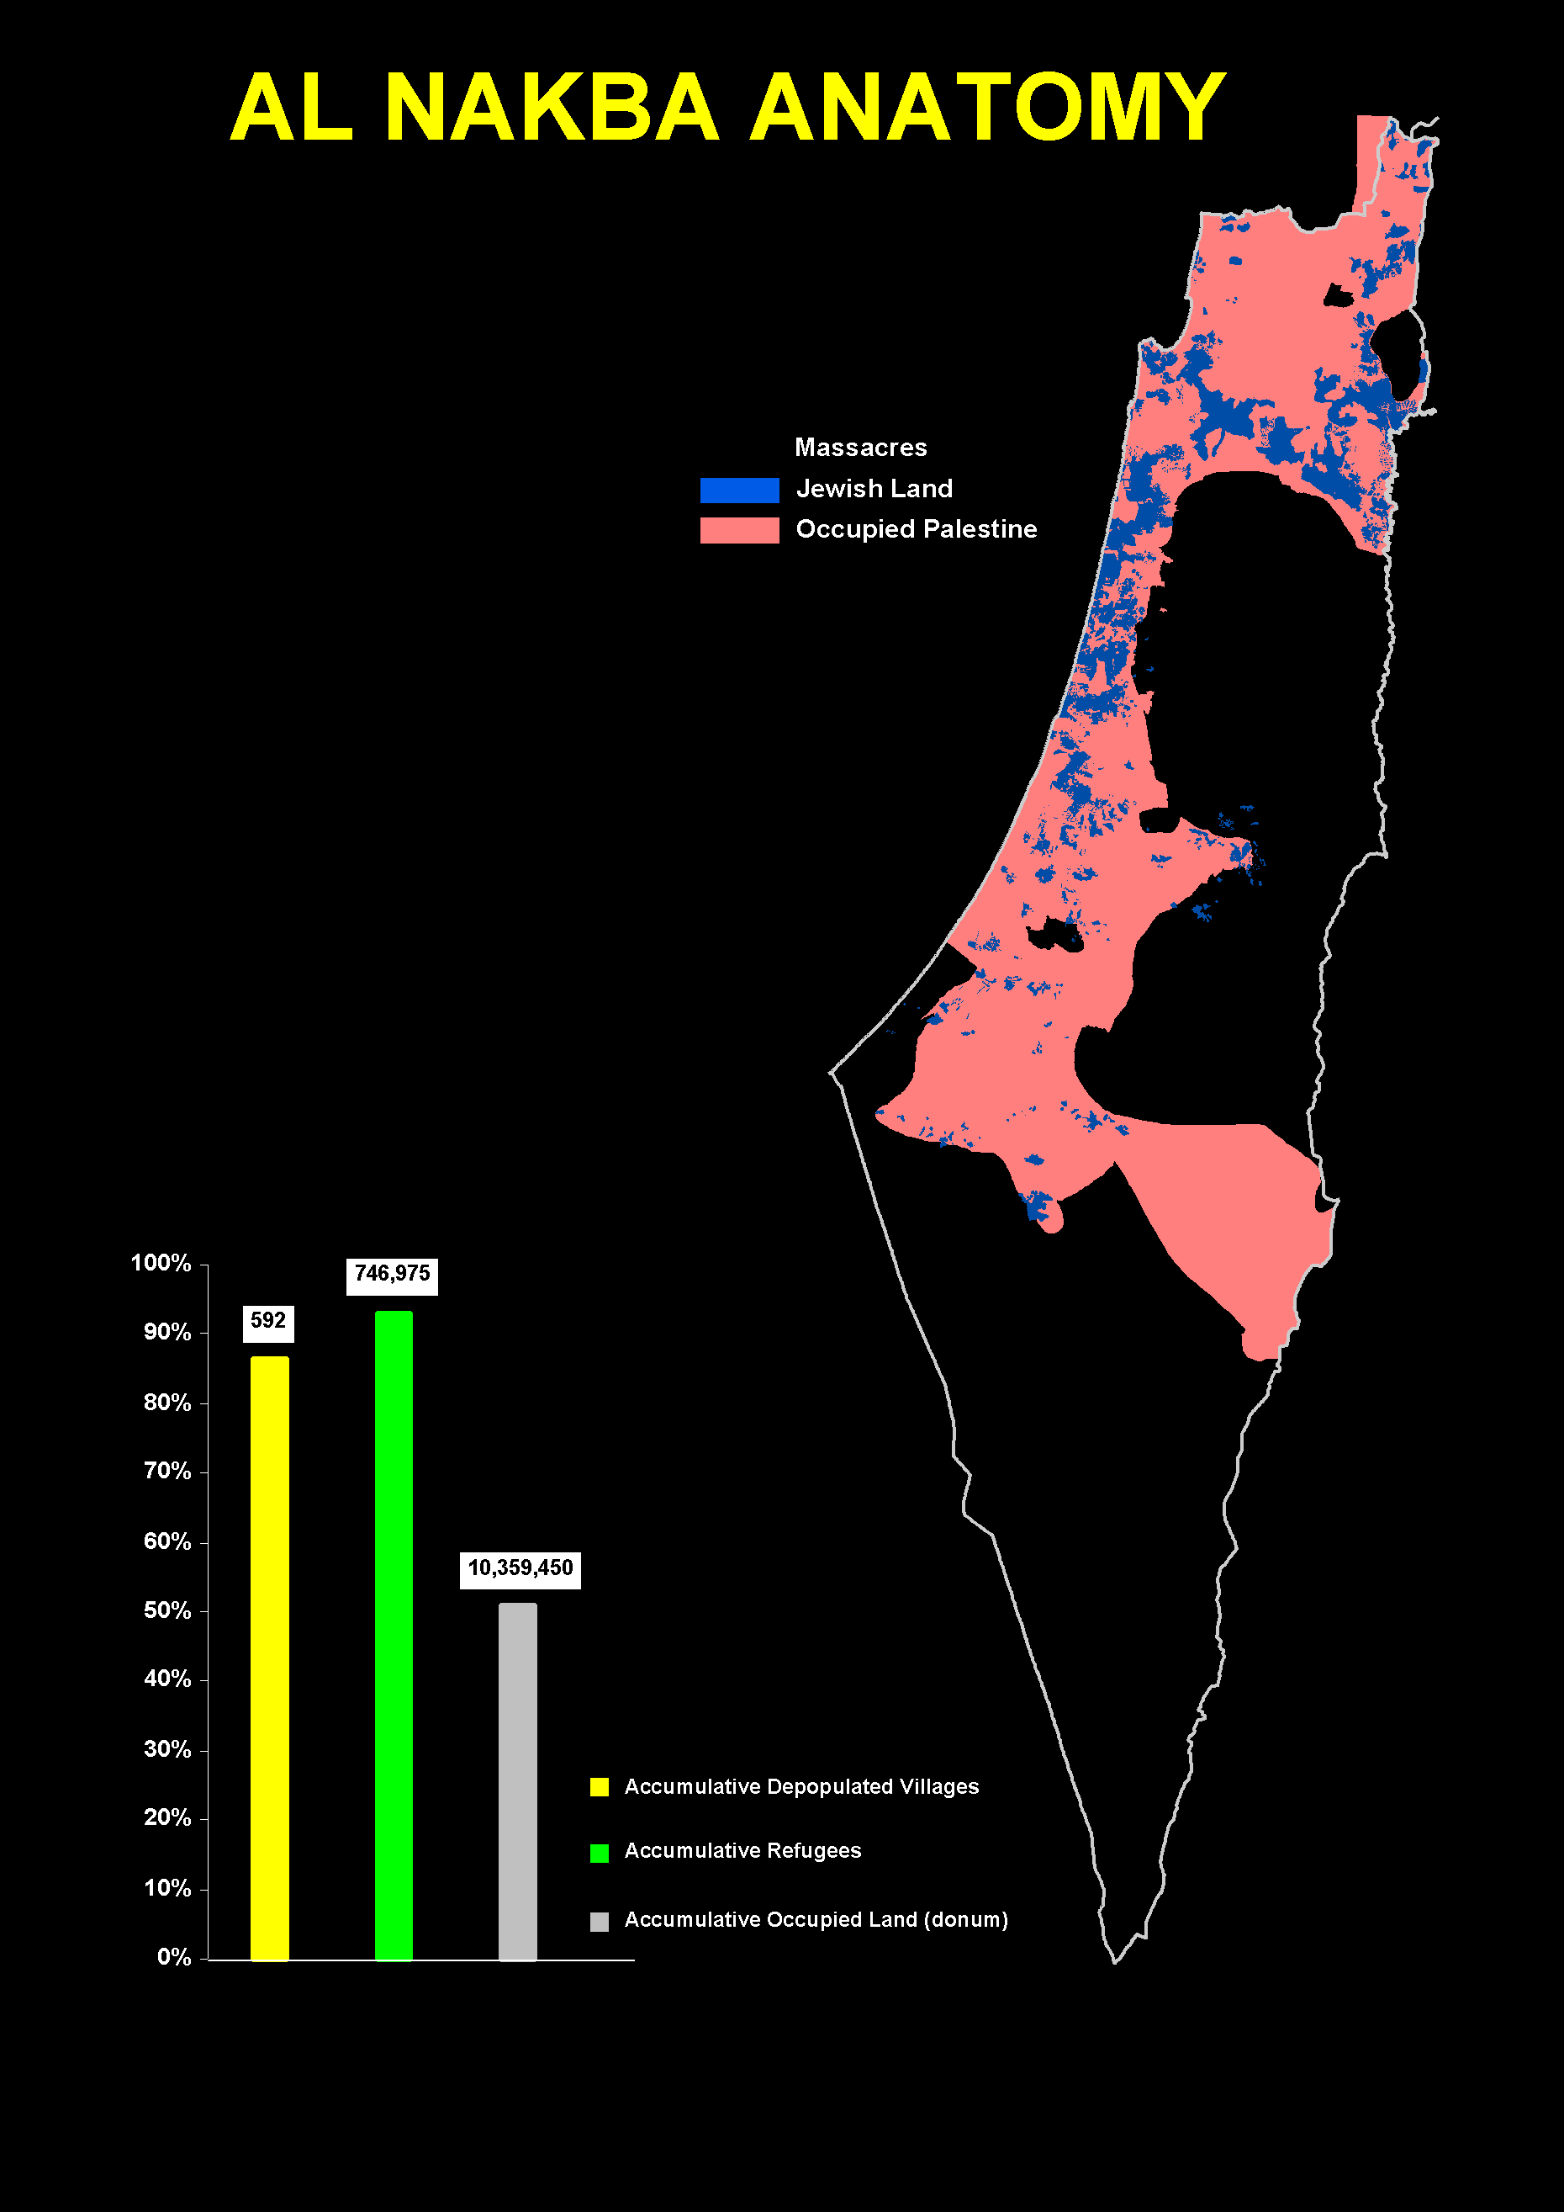
Date Israeli Conquest Operation
31 March 1948
Plan Dalet
15 April 1948
Nachson
30 April 1948
Har’el Misparayim, Chametz, Yevussi
15 May 1948
Yiftach, Matate, Gideon, barak
31 May 1948
Ben Ami, Qilshon, Ben Nun
15 June 1948
Yoram
30 June 1948
Truce
15 July 1948
Dani, Dekel, an Far
31 July 1948
Qedem, Shoter
15 Aug 1948
Truce
31 Aug 1948
Truce
15 Sep 1948
Truce
30 Sep 1948
Truce
15 Oct 1948
Truce
31 Oct 1948
ha har, Yo’av
15 Nov 1948
Hiram
30 Nov 1948
Lot
Israelis occupied Dead Sea area.

Slide 15
Date Israeli Conquest Operation
31 March 1948
Plan Dalet
15 April 1948
Nachson
30 April 1948
Har’el Misparayim, Chametz, Yevussi
15 May 1948
Yiftach, Matate, Gideon, barak
31 May 1948
Ben Ami, Qilshon, Ben Nun
15 June 1948
Yoram
30 June 1948
Truce
15 July 1948
Dani, Dekel, an Far
31 July 1948
Qedem, Shoter
15 Aug 1948
Truce
31 Aug 1948
Truce
15 Sep 1948
Truce
30 Sep 1948
Truce
15 Oct 1948
Truce
31 Oct 1948
ha har, Yo’av
15 Nov 1948
Hiram
30 Nov 1948
Lot
15 Dec 1948
Assaf
Israelis tried to dismember
Gaza Strip
crowded with refugees
but failed.

Slide 16
Date Israeli Conquest Operation
31 March 1948
Plan Dalet
15 April 1948
Nachson
30 April 1948
Har’el Misparayim, Chametz, Yevussi
15 May 1948
Yiftach, Matate, Gideon, barak
31 May 1948
Ben Ami, Qilshon, Ben Nun
15 June 1948
Yoram
30 June 1948
Truce
15 July 1948
Dani, Dekel, an Far
31 July 1948
Qedem, Shoter
15 Aug 1948
Truce
31 Aug 1948
Truce
15 Sep 1948
Truce
30 Sep 1948
Truce
15 Oct 1948
Truce
31 Oct 1948
ha har, Yo’av
15 Nov 1948
Hiram
30 Nov 1948
Lot
15 Dec 1948
Assaf
31 Dec 1948
Horev
Israelis advanced
into Sinai (not shown),
threatened al Arish
but were forced to withdraw
under British pressure.

Slide 17
Date Israeli Conquest Operation
31 March 1948
Plan Dalet
15 April 1948
Nachson
30 April 1948
Har’el Misparayim, Chametz, Yevussi
15 May 1948
Yiftach, Matate, Gideon, barak
31 May 1948
Ben Ami, Qilshon, Ben Nun
15 June 1948
Yoram
30 June 1948
Truce
15 July 1948
Dani, Dekel, an Far
31 July 1948
Qedem, Shoter
15 Aug 1948
Truce
31 Aug 1948
Truce
15 Sep 1948
Truce
30 Sep 1948
Truce
15 Oct 1948
Truce
31 Oct 1948
ha har, Yo’av
15 Nov 1948
Hiram
30 Nov 1948
Lot
15 Dec 1948
Assaf
31 Dec 1948
Horev
15 Jan 1949
Magrefa
Israelis started to kill
returning refugees,
so-called “infiltrators”.

Slide 18
Date Israeli Conquest Operation
31 March 1948
Plan Dalet
15 April 1948
Nachson
30 April 1948
Har’el Misparayim, Chametz, Yevussi
15 May 1948
Yiftach, Matate, Gideon, barak
31 May 1948
Ben Ami, Qilshon, Ben Nun
15 June 1948
Yoram
30 June 1948
Truce
15 July 1948
Dani, Dekel, an Far
31 July 1948
Qedem, Shoter
15 Aug 1948
Truce
31 Aug 1948
Truce
15 Sep 1948
Truce
30 Sep 1948
Truce
15 Oct 1948
Truce
31 Oct 1948
ha har, Yo’av
15 Nov 1948
Hiram
30 Nov 1948
Lot
15 Dec 1948
Assaf
31 Dec 1948
Horev
15 Jan 1949
Magrefa
Armistice
31 Jan 1949
Egypt agreed to sign
the first Armistice Agreement
with Israel.

Slide 19
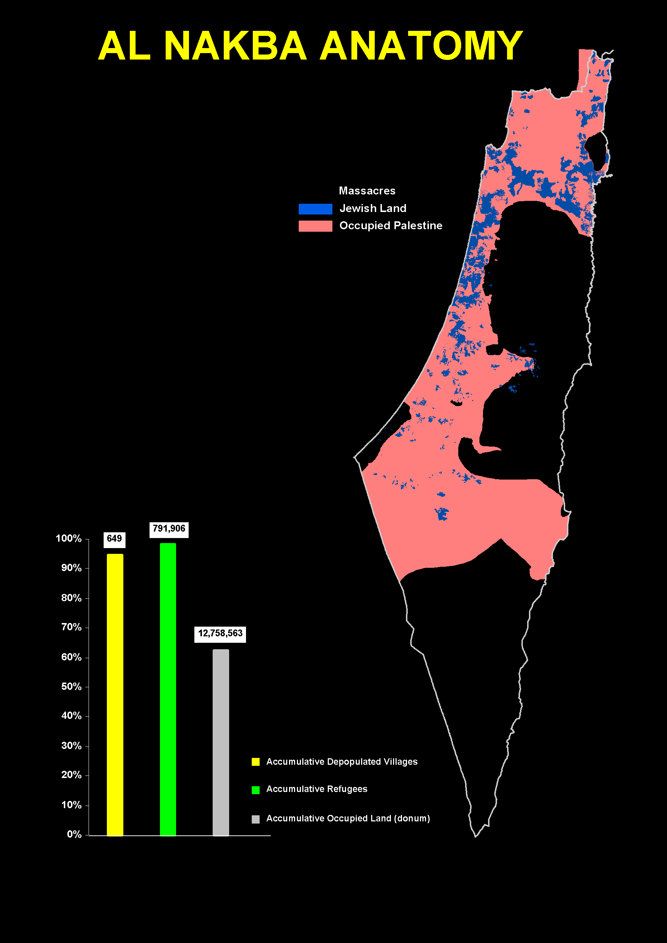
Date Israeli Conquest Operation
31 March 1948
Plan Dalet
15 April 1948
Nachson
30 April 1948
Har’el Misparayim, Chametz, Yevussi
15 May 1948
Yiftach, Matate, Gideon, barak
31 May 1948
Ben Ami, Qilshon, Ben Nun
15 June 1948
Yoram
30 June 1948
Truce
15 July 1948
Dani, Dekel, an Far
31 July 1948
Qedem, Shoter
15 Aug 1948
Truce
31 Aug 1948
Truce
15 Sep 1948
Truce
30 Sep 1948
Truce
15 Oct 1948
Truce
31 Oct 1948
ha har, Yo’av
15 Nov 1948
Hiram
30 Nov 1948
Lot
15 Dec 1948
Assaf
31 Dec 1948
Horev
15 Jan 1949
Magrefa
Armistice
31 Jan 1949
Armistice
15 Feb 1949
Israel consolidated its positions
in the newly occupied area,
63% of Palestine.

Slide 20
Date Israeli Conquest Operation
31 March 1948
Plan Dalet
15 April 1948
Nachson
30 April 1948
Har’el Misparayim, Chametz, Yevussi
15 May 1948
Yiftach, Matate, Gideon, barak
31 May 1948
Ben Ami, Qilshon, Ben Nun
15 June 1948
Yoram
30 June 1948
Truce
15 July 1948
Dani, Dekel, an Far
31 July 1948
Qedem, Shoter
15 Aug 1948
Truce
31 Aug 1948
Truce
15 Sep 1948
Truce
30 Sep 1948
Truce
15 Oct 1948
Truce
31 Oct 1948
ha har, Yo’av
15 Nov 1948
Hiram
30 Nov 1948
Lot
15 Dec 1948
Assaf
31 Dec 1948
Horev
15 Jan 1949
Magrefa
Armistice
31 Jan 1949
Armistice
15 Feb 1949
Armistice
28 Feb 1949
Egypt signed
Armistice Agreement
on 24th February 1949.

Slide 21
Date Israeli Conquest Operation
31 March 1948
Plan Dalet
15 April 1948
Nachson
30 April 1948
Har’el Misparayim, Chametz, Yevussi
15 May 1948
Yiftach, Matate, Gideon, barak
31 May 1948
Ben Ami, Qilshon, Ben Nun
15 June 1948
Yoram
30 June 1948
Truce
15 July 1948
Dani, Dekel, an Far
31 July 1948
Qedem, Shoter
15 Aug 1948
Truce
31 Aug 1948
Truce
15 Sep 1948
Truce
30 Sep 1948
Truce
15 Oct 1948
Truce
31 Oct 1948
ha har, Yo’av
15 Nov 1948
Hiram
30 Nov 1948
Lot
15 Dec 1948
Assaf
31 Dec 1948
Horev
15 Jan 1949
Magrefa
Armistice
31 Jan 1949
Armistice
15 Feb 1949
Armistice
28 Feb 1949
Uvdah
15 March 1949
Israelis occupied southern Palestine
after Armistice Agreement was signed.

Slide 22
Date Israeli Conquest Operation
31 March 1948
Plan Dalet
15 April 1948
Nachson
30 April 1948
Har’el Misparayim, Chametz, Yevussi
15 May 1948
Yiftach, Matate, Gideon, barak
31 May 1948
Ben Ami, Qilshon, Ben Nun
15 June 1948
Yoram
30 June 1948
Truce
15 July 1948
Dani, Dekel, an Far
31 July 1948
Qedem, Shoter
15 Aug 1948
Truce
31 Aug 1948
Truce
15 Sep 1948
Truce
30 Sep 1948
Truce
15 Oct 1948
Truce
31 Oct 1948
ha har, Yo’av
15 Nov 1948
Hiram
30 Nov 1948
Lot
15 Dec 1948
Assaf
31 Dec 1948
Horev
15 Jan 1949
Magrefa
Armistice
31 Jan 1949
Armistice
15 Feb 1949
Armistice
28 Feb 1949
Uvdah
15 March 1949
Armistice
31 March 1949
Lebanon signed Armistice Agreement
on 23rd March 1949.

Slide 23
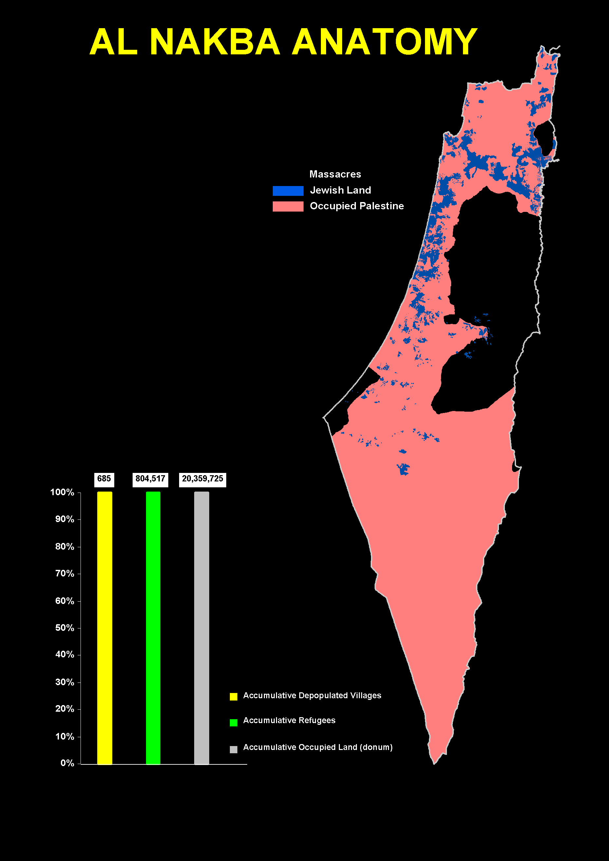
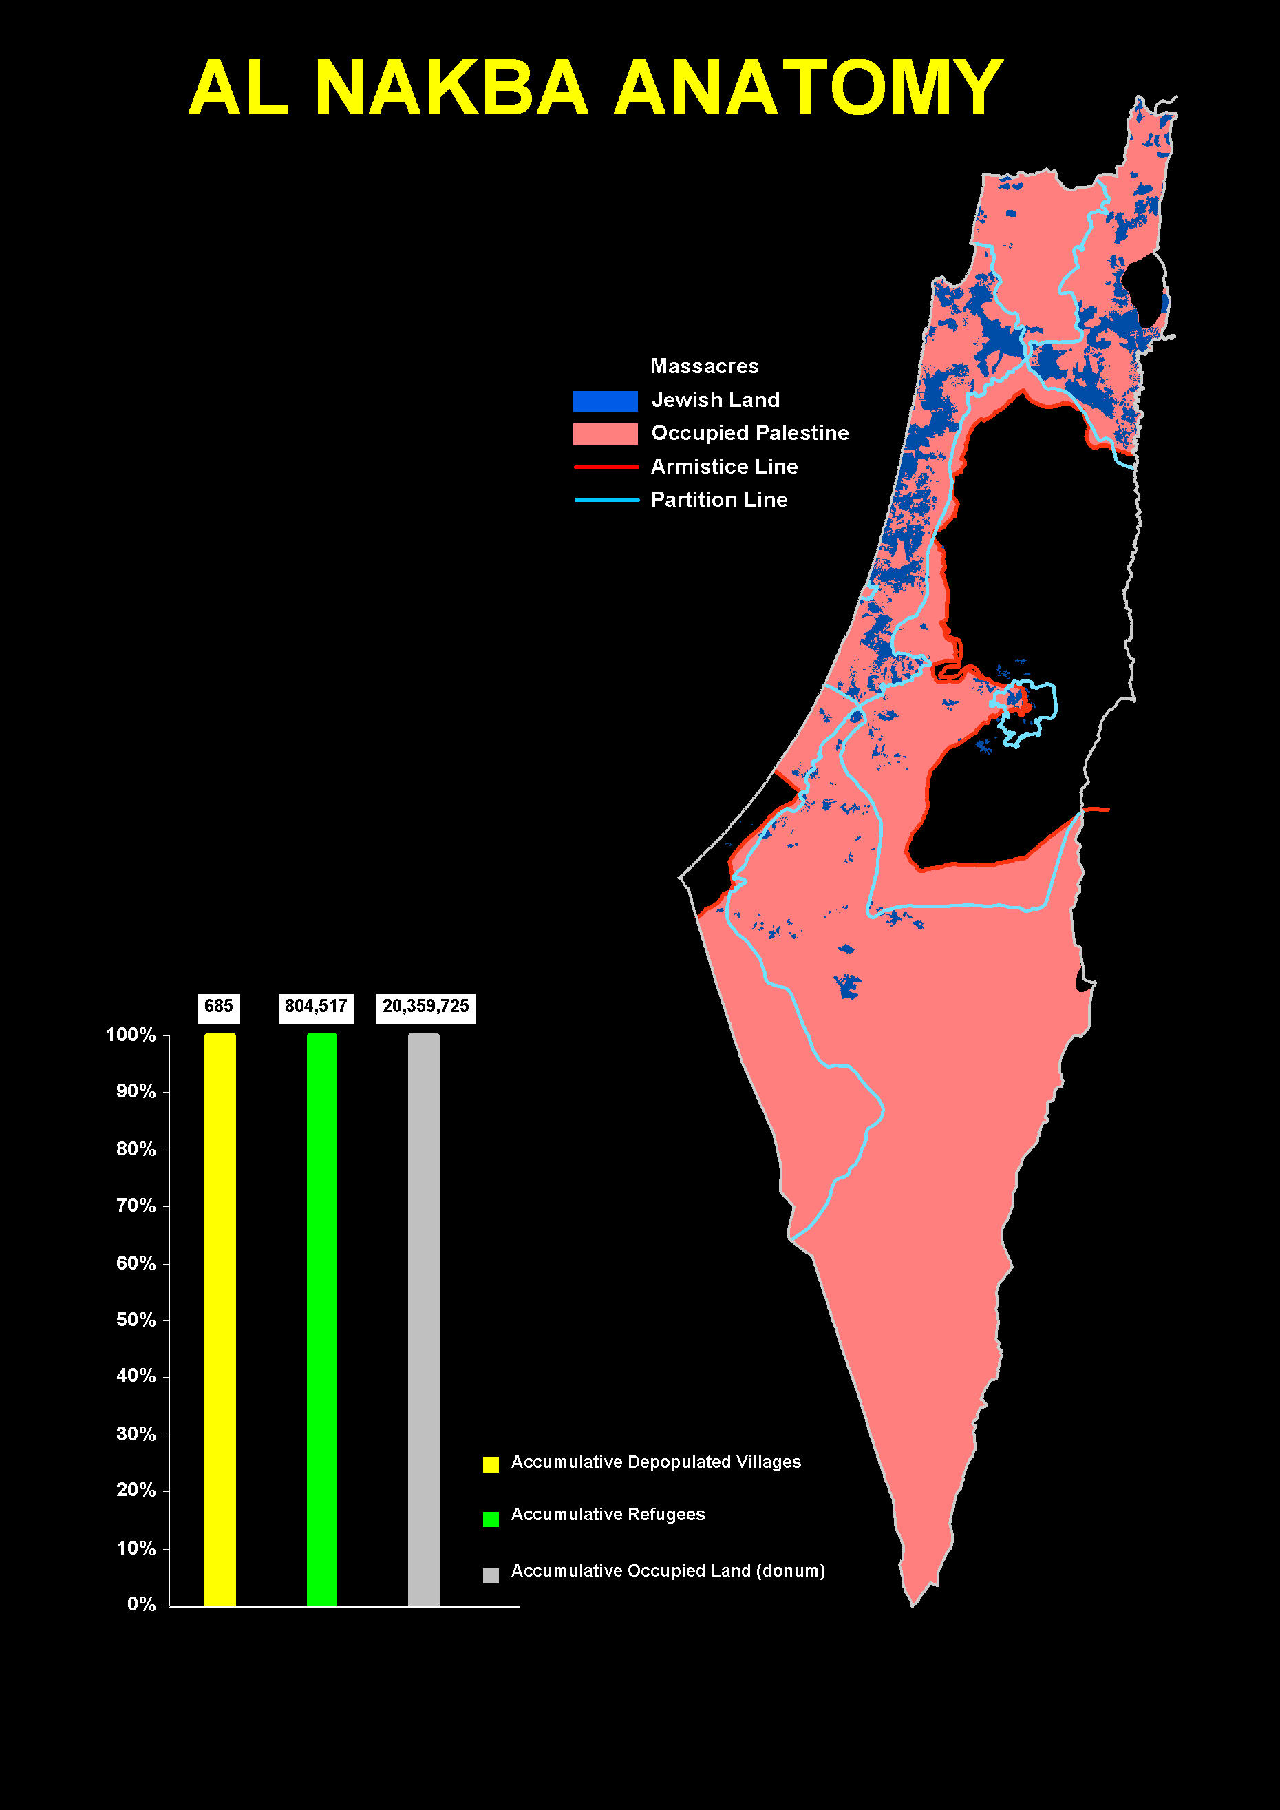
Date Israeli Conquest Operation
31 March 1948
Plan Dalet
15 April 1948
Nachson
30 April 1948
Har’el Misparayim, Chametz, Yevussi
15 May 1948
Yiftach, Matate, Gideon, barak
31 May 1948
Ben Ami, Qilshon, Ben Nun
15 June 1948
Yoram
30 June 1948
Truce
15 July 1948
Dani, Dekel, an Far
31 July 1948
Qedem, Shoter
15 Aug 1948
Truce
31 Aug 1948
Truce
15 Sep 1948
Truce
30 Sep 1948
Truce
15 Oct 1948
Truce
31 Oct 1948
ha har, Yo’av
15 Nov 1948
Hiram
30 Nov 1948
Lot
15 Dec 1948
Assaf
31 Dec 1948
Horev
15 Jan 1949
Magrefa
Armistice
31 Jan 1949
Armistice
15 Feb 1949
Armistice
28 Feb 1949
Uvdah
15 March 1949
Armistice
31 March 1949
Armistice
15 April 1949
Land Ceded by King Abdullah
through blackmail.
Jordan signed Armistice Agreement
on 3rd April 1949.
Syria signed Armistice Agreement
on 20th July 1949.

Slide 24
AL NAKBA means …
- 685 depopulated villages
- 805,000 refugees, now over 6,000,000
- 70 massacres committed to enforce ethnic cleansing
- 78% of Palestine is Israeli- occupied
- which is,
14 times the area of Jewish land
6 times the area conquered when Israel was declared
24% over and above the recommended Partition Plan
THE NAKBA STILL GOES ON …

